Slide 1


Slide 2
How to be always connected?
Join us on Facebook:
www.facebook.com/ARK.technosolution
Get ARK’s updates on phone :
Just SMS ON ARK_techworld to 9870807070
Visit Us @
www.arktechnosolutions.com

Slide 3
About Us….
The lack of robotics exposure urged to the conceptualization of ARK Technosolutions, Mumbai in 2008.
We are a national leader in Robotics Education and providing solutions in Robotics and Embedded System Design.
Our courses have been conducted in IIT’s, NIT’s and many India’s reputed engineering colleges, thus amounting to training more than 50,000 students across India.

Slide 4
Our Vision….
We envisage India as the hub in the field of Robots & embedded System technology in the years to come.
According to an IDC report the international market as a whole expects product development worth $100 billion, which will require as many as 400,000 trained professionals in embedded systems development by the year 2014

Slide 5
Our Domains…..
Currently ARK Technosolutions is largely divided into four domains:
ARK Training Centre (for Engineering Students).
ARK RoboJunior (for School & Jr. College Students).
ARK Embedded Systems (PG Courses for Graduates and Professionals).
ARK Industrial Solutions – Research & Development.

Slide 6
Our Clients
IIT – Kharagpur IIT – Delhi IIT - Kanpur
IIT – Bombay IIT – Hyderabad IIT – Roorkee
NIT - Kurukshetra IIT- Patna NIT - Durgapur
IIT- Gandhinagar IIT – Indore GCET - Anand
IT BHU – Varanasi MNNIT - Allahabad NIT - Rourkela
JNTU – Hyderabad DAVIET - Jalandhar ADIT – Gujrat
NMIT – Nitte BVPCOE – Pune BITS – Pillani
WCE – Sangli MES – Chiplun DY Patil - Pune
HIT – Kolkata HBTI – Kanpur NSEC - Kolkata
MITCOE – Pune DAIICT – Gandhinagar PIT - Baroda
MSU-IT – Baroda MMCOE – Pune SVP Polytechni-Mumbai
KJ SOMAIYA – Mumbai IGIT – DelhI MGIT - Hyderabad
YCCE – Nagpur PBVR COE – Hyderbad PICT - Pune
Ndmvcoe – Nashik RKNEC – Nagpur CBIT - Hyderabad
FAMT – Ratnagiri SIT – Lonavala BVRIT – Hyderabad

Slide 7
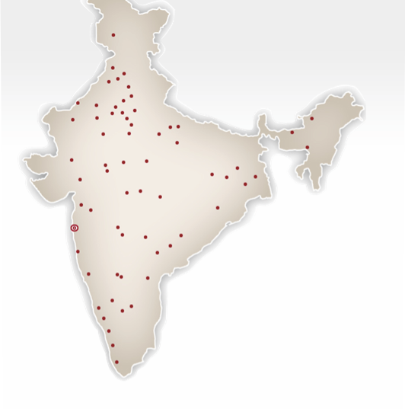
OUR REACH..

Slide 8
Sixth Sense Robotics
A Vision Based Robotics Workshop
-by team ARK

Slide 9
Day -1: Session-1

Slide 10
ROBOT
What is a ROBOT ?
Define a ROBOT in your own words.

Slide 11
ROBOT
The word ‘Robot’ comes from the Czech word ‘Robota’ which means ‘forced labour’

Slide 12
WHAT IS A ROBOT?
Electro-mechanical device
Performs Various tasks
May be human controlled or automated
It finds it’s uses in all aspects of our life.
ROBOT

Slide 13
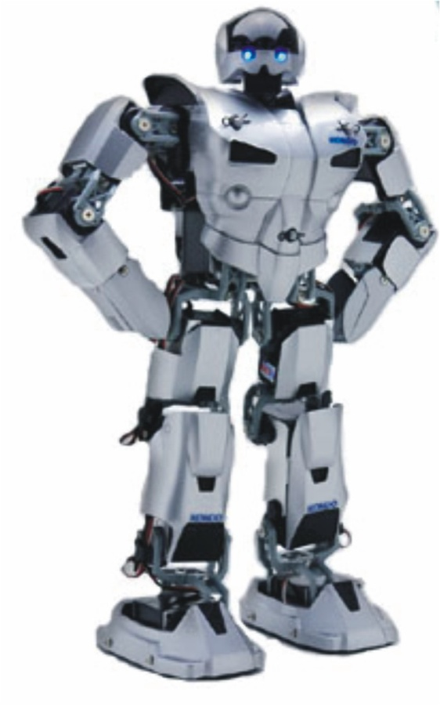
APPLICATION OF ROBOTS
Industry
Medical
Military
Space Exploration
Research & Development

Slide 14
Various Student Level Robots

Slide 15

Importance Of Vision In Human Life
Identify things on basis of color and shape.
Classify things.
Scan differences.
Recognize feelings.

Slide 16
VCM (Vision Controlled Machine)
What do you mean by VCM?
Give some practical example of VCM….

Slide 17
Application Of Vision In Machine
Line Follower.
Color Recognition.
Shape Recognition.
Spying.
Tele Surgery.
Object recognition and comparison.
Humanoids.
Industrial Applications.

Slide 18
Image Acquisition Device
Image Processor
Image Analysis Tool
Machine Control
System Description of a VCM

Slide 19
Image Acquisition Devices
Camera
CCD sensor based.
CMOS sensor based.
Further classified as:
Analog Camera.
Digital Camera

Slide 20
Comparison Between CCD and CMOS
CC Device
  Charged couple device.
  In a CCD device, the charge is actually transported across the chip and read at one corner of the array as a continuous voltage ,pixel by pixel.
  High quality, low noise image.
  Fabrication Cost is high.
  Consume 100 times more power than CMOS.
  Longer life.
CMOS device
  Complementary MOS device.
  In most CMOS devices, there are several transistors at each pixel that amplify and move the charge using more traditional wires.
  Low quality images that are susceptible to noise.
  Fabrication cost is low.
  They consume very less power.
  Smaller life compared to CCD.

Slide 21
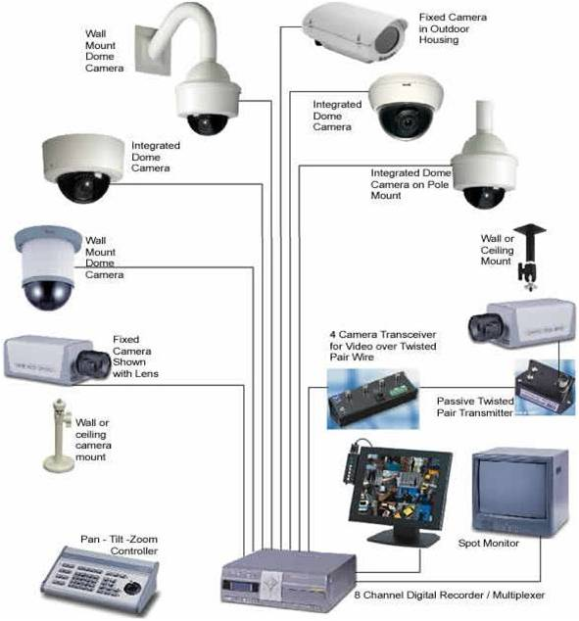
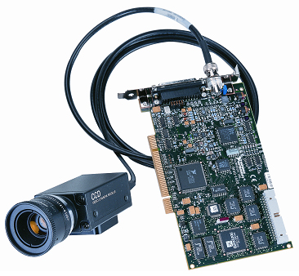
Analog Camera
Consists of a image grabber (lens).
It requires suitable grabbing card or a TV tuner card for interfacing with PC.
Examples:

Slide 22
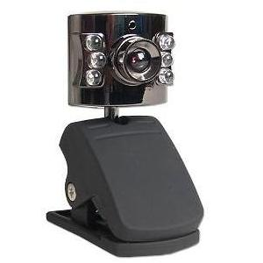
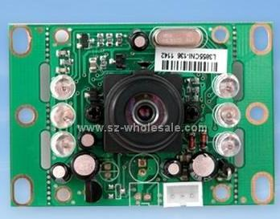
Digital Cameras
Consists of a lens.
Inbuilt ADC.
Suitable interface (eg: USB)
Example:

Slide 23
Selection Criteria For Camera
On basis of application.
On basis of cost.
On basis of processor used.

Slide 24
Tools For Image Processing
CV(Computer Vision)
SCILAB
MATLAB

Slide 25
Getting Started With Matlab
MATLAB (MATrix LABoratory).
It’s a numerical computing environment and a fourth-generation programming language.
Its used in various fields like engineering, sciences and economics.
Important windows in MATLAB.
Command window.
Workspace.
Current directory.
Command history.

Slide 26
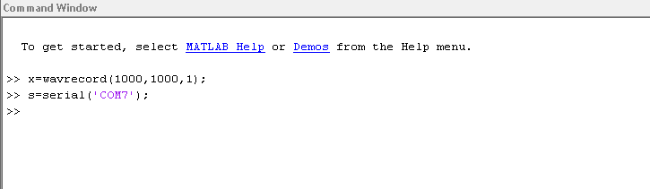
Command Window

Slide 27
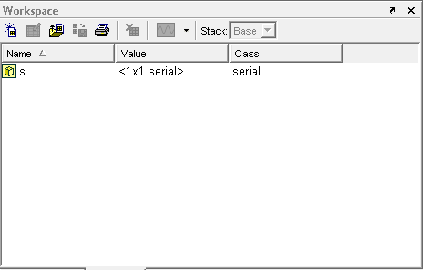
Workspace

Slide 28
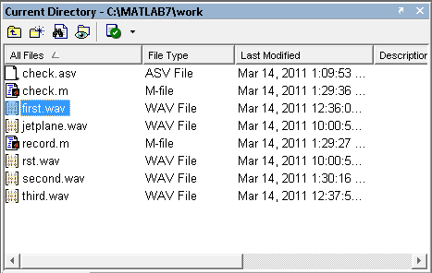
Current Directory

Slide 29
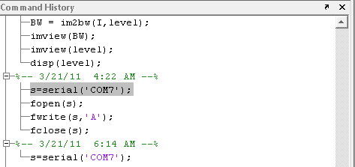
Command History

Slide 30
Writing General Programs On MATLAB
Request user for the input.
input(‘statement’) %syntax
input(‘how many apples’) % displays the statement in inverted comma.
input(‘what is your name’ , ’s’) %waits for a string input

Slide 31
Display the required statement or any of the workspace components.
disp ‘statement’ % syntax
disp (workspace component) % syntax

Slide 32
Conditional Statements
While loop:-
while expression
statements
end
If and Else If statements:-
if expression
statements
elseif expression
statements
else
statements
end

Slide 33
for statement
for i = 1:n
statement
end
it also supports switch case statement.
The BREAK statement can be used to terminate the loop prematurely.

Slide 34
Day -1: Session-2

Slide 35

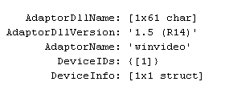
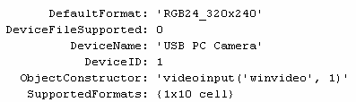
Getting Ahead With Acquiring A Image
Getting info about adapters.
Getting info about the webcams.
Getting details about the webcam.

Slide 36
Generating A Video Object And Previewing A Video
Creating a video object.
Preview it.
Two techniques of getting a image from the video.
Using trigger method.
Using Getsnapshot.
Ending The Video Object.

Slide 37
Recognizing Color
# step 1: Create a video object.
# step 2: Get a picture.
# step 3: Image conversion in suitable form.
# step 4: Thresholding.
# step 5: Fill the background.
# step 6: Create a morphological structuring element.
# step 7: Erosion & Dilation.
# step 8: See the image.

Slide 38
Interfacing Your Hardware With PC
MATLAB provides support to access serial port (also called as COM port) and parallel port (also called as printer port or LPT port) of a PC.

Slide 39
MATLAB code for accessing the serial port is as follows:
>> ser=serial(object);
>> fopen (ser);
To send data through the serial port, the available commands
>> fwrite (ser,1);
You can close the port in case there are other applications using this port using the fclose command.
>> fclose (ser);

Slide 40
ARDUINO circuit board
Micro Controller - ATMEL ATmega 8
Operating Voltage - 5V
Input voltage - 6V-20V
Digital I/O pins - 14 out of which 6 provide PWM
Analog Input Pins - 8
DC Current per I/O pin - 40mA.
Flash Memory - 16KB
SRAM - 1KB
EEPROM - 512Bytes
Clock Speed 16 MHz
USB-UART converter
Proper Indicator LED's
USB/ EXT input voltage
5V output supply pins - 3
3.3 V output supply pins - 1

Slide 41
Day -2: Session-1

Slide 42
DC Motor Direction Control
V_{CC}
Data | S1 | S2
00 | OFF | OFF
01 | OFF | ON
10 | ON | OFF
11 | ON | ON
S₁
S₂
₊
M
₋
__
S₁
__
S₂
H – Bridge Circuit Diagram

Slide 43
DUAL CHANNEL H – BRIDGE IC L293D
V_{CC}
V_{CC}
S₁
S₂
S₃
S₄
M
M
__
S₁
__
S₂
__
S₃
__
S₄
1
2
1
2
Notes:
43

Slide 44
Ball Following Robot
Recognize ball.
Get the location of ball.
Generate algorithm to follow that ball.

Slide 45
Day -2: Session-2

Slide 46
Gesture Controlled Media Player
Initialize media player.
Recognize gesture.
Assign functions according to the gesture.

Slide 47
Thank You
“Have fun with Sixth Sense robotics “
-by team ARK

Slide 48
Color Recognition Application On Board
Recognize color.
Label the Blobs.
Generate an output function on board.

Slide 49
Contact us:
ARK Technosolutions,
We Speak To Educate
Office :022-4023 (ROBO) 7626
Email: info@arktechnosolutions.com
Web: www.arktechnosolutions.com

